Slide 1



Expanding the horizon of Global Maritime Healthcare
End-to-end Maritime Healthcare Management | Innovative & Technology empowered Most accredited Organisation | Expansive Healthcare Network I Reliable & Trustworthy
www.medshield.in

Slide 2
Maritime Healthcare
Key Industry 2024
Growth and Challenges
CY 2024 Key Highlights
New Additions
Environment Friendly
Insights
The global cruising industry is booming with record growth and expansion
But it comes with rising operational challenges
34+ Million guests served
11More + million crew members handled
Countless itineraries successfully delivered
A total of 11 new cruise ships were launched.
Capacity of 28000+ Passengers and 9000+ Crew is added
Over 50% of new cruise ships use LNG instead of diesel.
69% of diesel ships now have exhaust systems that remove 98% of sulphur.
96% of non-LNG new ships will include these exhaust cleaning systems.
Crew Repatriation Statistics
Breakdown of Causes
Medical Expenses Inflation
Intangible Loss
1.6% of the total crew size required medical disembarkation and/or repatriation
Many of these cases involved Indian crew members
62.3% due to illness
37.7% due to onboard injuries
The overall medical expenses inflation rate is growing by 10% YoY globally.
Disembarkation/Repatriation cost of crew due to medical reasons have escalated around 25% from the last two years.
Delayed re-employment integration, Attrition, reduced employer brand loyalty etc are a few undesired effects.
Inadequate supply of quality manpower, etc
Challenges
2

Slide 3

Mission
Global Maritime Healthcare
Who We Are & Our Strengths
To deliver tech-driven, people-focused healthcare and claims solutions that reduce risks, control costs, and empower maritime operations.
Vision
About us
Experts in Maritime Healthcare for the global cruise and marine industries. 10+ Years of Trust serving cruise lines, shipping agencies, and employers. End-to-End Support in medical care and claims management. Efficient & Compassionate, so clients can focus on sailing forward.
To elevate maritime healthcare with world-class care, innovative solutions, and a strong focus on seafarer well-being and safety at sea.
3

Slide 4

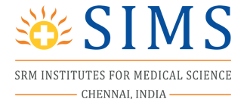







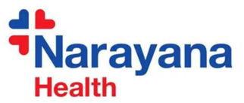



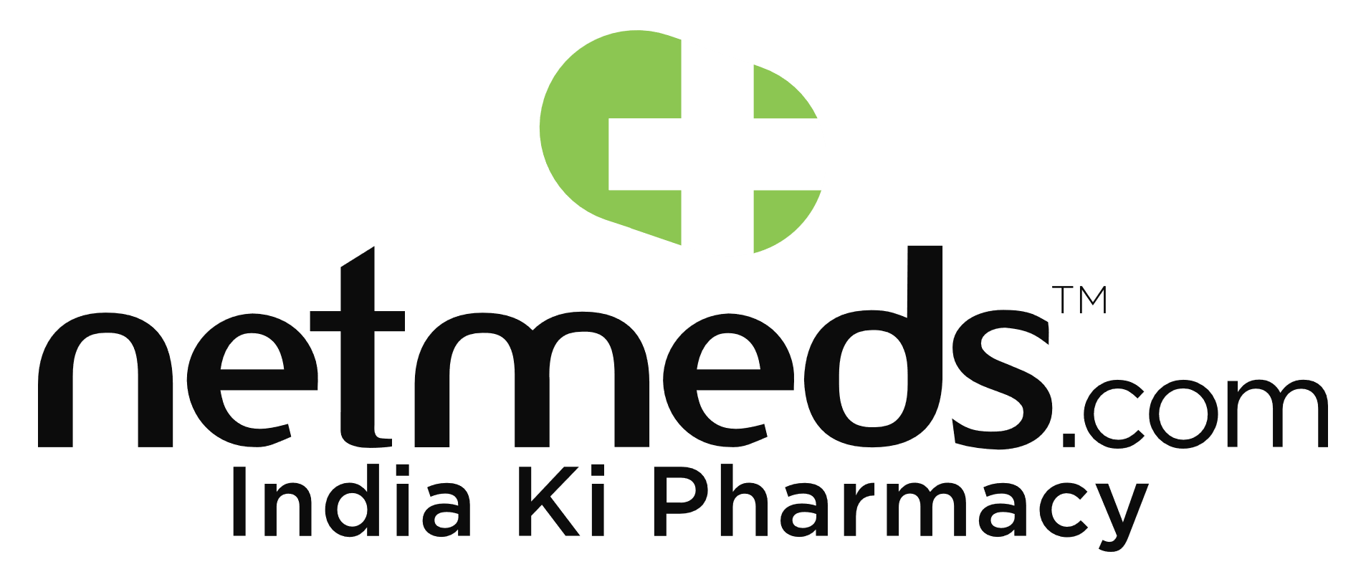





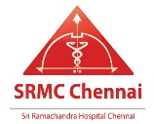






Maritime Healthcare
Our Network, Reach & Partnerships
Our Network
Partners & Vendors
MedShield links 1,800 hospitals, + healthcare centers for smooth care of maritime personnel.
Offices located in India, UAE, and Singapore.
xxxxxxxxxxxxxxxxxxxxxxxxxxxxxxxxxxxxxx
Accreditations & Certifications
Industry affiliations & Quality Certifications
4

Slide 5

Maritime Healthcare
Meet the Experts: Medshield’s SME Panel
At Medshield, our Subject Matter Experts (SMEs) are integral to delivering unparalleled service in maritime healthcare and claims management. Representing a range of specialized disciplines, each team brings a wealth of knowledge and expertise to address the unique challenges faced by the marine and cruise industries.
Maritime Medical Specialist and Super Specialist
Telemedicine Team
Maritime Healthcare and Claims Specialists
Clinical Findings Correlation Team
Treatment Plan Analysis Team
Global Pharmacology Experts
Occupational Preventive Healthcare Experts
Medico-Legal Team
Technology Team
5

Slide 6







Core
CMS
SMEs
Advisors
Coordinating between all stakeholders, our Case Managers keep operations on track, ensuring timely updates and decisions.
MedShield’s SMEs provide the deep industry-specific knowledge that allows us to stay at the cutting edge of maritime healthcare services.
Specializing in complex maritime claims, this team ensures fair, compliant resolutions based on global regulatory standards.
TEAM
Medical Expert
Pharmacologists
IT Team
Our panel of maritime medical specialists, doctors, and nurses provide continuous care from emergency interventions to ongoing treatment.
Our pharmacologists ensure safe and compliant medication use, while our healthcare strategists focus on improving the overall health and operational efficiency of maritime personnel.
Our 24/7/365 tech enablement team ensures that MedShield’s digital infrastructure is always running smoothly, supporting seamless operations and enhancing client satisfaction.

Slide 7
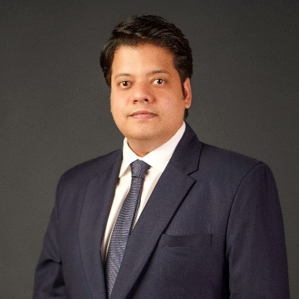
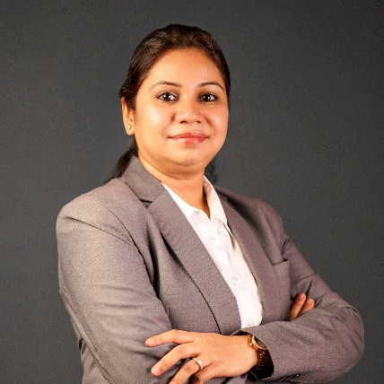
Dr. Desikan Setlur – Visionary Founder of MedShield
Revolutionizing Maritime Healthcare: Transformed the industry with a seafarer-first, innovation-led approach.
Strategic Leadership: Over 20 years of expertise driving operational excellence and healthcare delivery at sea.
Academic Excellence: Ph.D. in Maritime Occupational Health & Safety from Swansea University, U.K.
Specialized Expertise: Mastery in medical evacuations, port operations, and claims management.
Global Reach: Leverages a worldwide network and deep industry insight to provide trusted health solutions.
Tech-Driven Solutions: Pioneers seamless, efficient healthcare using cutting-edge technology.
Customer-First Philosophy: Ensures MedShield bridges the gap between medical need and operational demands.
Industry Trailblazer: Continues to set new benchmarks, shaping the future of maritime healthcare globally.
Dr.Desikan Setlur Founder | CEO
Dr. Princi Singh – Co-Founder of MedShield
Clinical & Operational Leader: Combines medical expertise with strategic leadership to redefine maritime healthcare.
Academic Foundation: BDS (Dental Surgery) graduate with specialized training in Hospital Management.
Decade of Experience: Over 10 years in healthcare, with a focus on innovation and service delivery.
Telemedicine Pioneer: Leads advancements in remote care and telemedicine for maritime environments.
Global Care Coordination: Drives seamless integration of medical solutions across international operations.
Operational Excellence: Streamlines healthcare delivery and optimizes systems for efficiency and scalability.
Patient-Centered Vision: Champions accessible, tech-driven care tailored to the needs of seafarers.
Driving Growth: Plays a key role in MedShield’s global expansion and future-focused healthcare strategies.
Dr. Princi Singh BDS | Certified Hospital Management Specialist
7

Slide 8


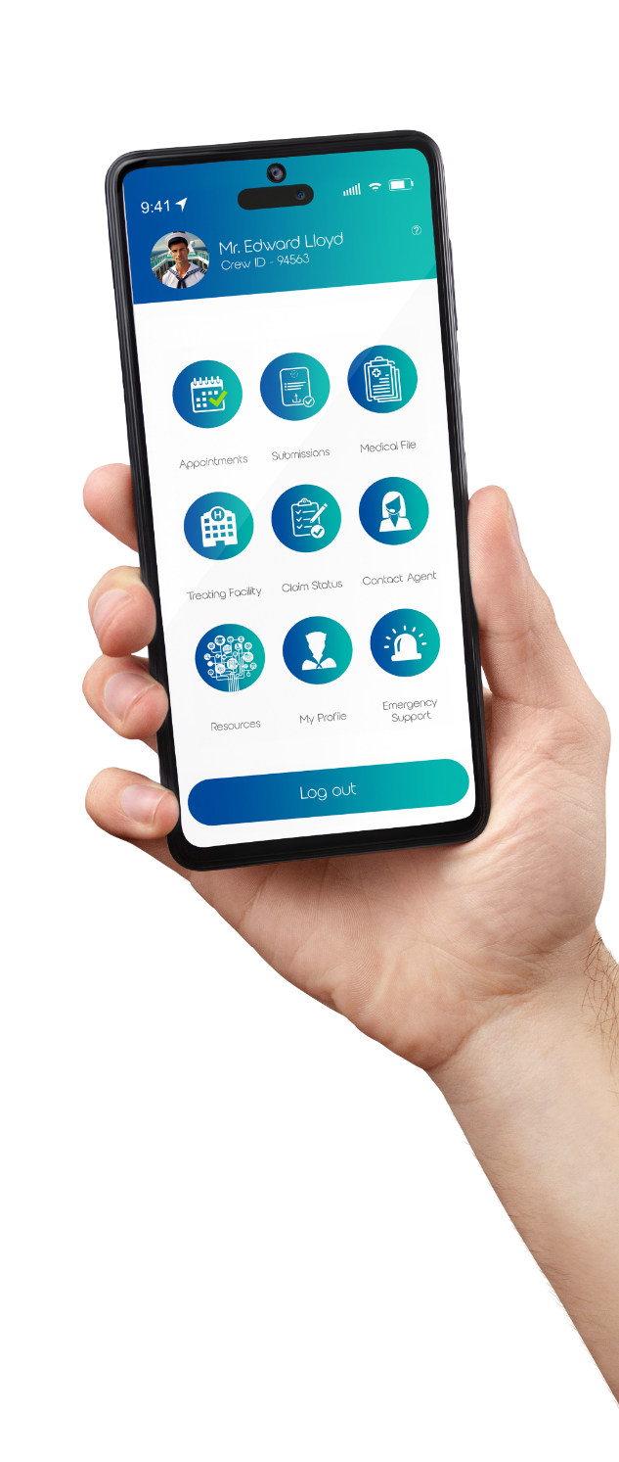
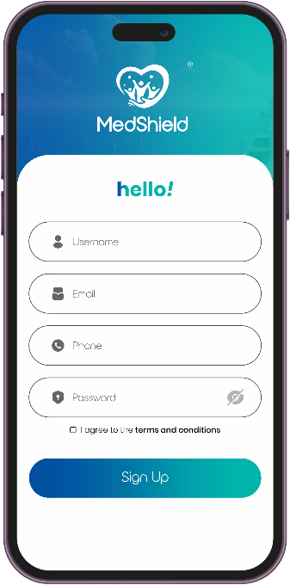
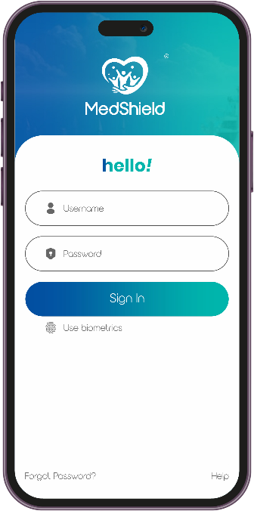

Maritime Healthcare
Valuechain Analysis
We use advanced mobile & administrative dashboards to streamline operations, improving both efficiency and client satisfaction.
Maritime Healthcare and Claims Specialists
Treatment Plan Analysis Team
Maritime Medical Specialist and Super Specialist
Telemedicine Team
Occupational Preventive Healthcare Experts
Clinical Findings Correlation Team
Global Pharmacology Experts
Medico-Legal Team
Technology Team
CMS
SMEs
Medical Expert
Pharmacologists
Advisors
IT Team
Technology Infrastructure
Features leveraging AI, OCR, Data Encryption & Seamless Automation.
8

Slide 9


01
Assignment of a Dedicated Case Management Specialist (CMS)
International Transaction Facilitation
05
02
Consultation with Internal Subject Matter Experts (SMEs)
Post-Treatment Monitoring and Support
06
Comprehensive Case Management for Medical Welfare
03
Hospital Treatment Facility Selection
Treating Doctor’s Fitness Report
07
04
Treatment Plan Approval Coordination
Records and Transaction Management Dashboard
08
9

Slide 10




Maritime Healthcare
Our Core Services
Medical Claims Management
Tele Medicine
MedShield specializes in efficient, reliable medical claims management for the maritime industry.
Our structured process ensures accurate validation, cost containment, and seamless reimbursements, minimizing employers' financial risks while protecting seafarers’ health rights.
We focus on fraud prevention, policy compliance, and dispute resolution, following global best practices.
Our advanced telemedicine solutions bridge geographical gaps, providing seafarers with instant access to medical specialists anywhere in the world.
Through secure platforms, we offer real-time consultations, remote diagnostics, and medical advice, ensuring timely intervention and preventing medical complications. |\
This service enhances crew well-being, reduces unnecessary evacuations, and optimizes healthcare costs for maritime employers.
10

Slide 11


Our Core Services
Claims Arbitration &
Legal Dispute Resolution
Maritime Medical Welfare Budgeting & Auditing
MedShield specializes in resolving maritime medical claims disputes efficiently.
Our experts navigate complex legal frameworks, MLC compliance, and employer liabilities, ensuring fair settlements for all stakeholders.
We mitigate risks related to fraud, ambulance-chasing, and excessive medical costs, protecting businesses while safeguarding seafarers’ rights.
Our arbitration services ensure swift, compliant, and equitable resolutions to minimize operational disruptions.
We provide strategic budgeting and auditing for maritime medical welfare, ensuring cost-efficient healthcare management without compromising quality.
Our team analyzes treatment plans, validates medical expenses, and prevents overbilling, optimizing resources for shipowners and employers.
With expertise in PEME audits, vessel-specific assessments, and financial planning, we help clients maintain transparent, well-regulated, and budget-friendly healthcare programs for their crew.
11

Slide 12






Case Study 1 - Optimizing Seafarer Treatment Costs
Problem
Investigation: Medshield found
Solutions: MedShield
A seafarer faced inflated medical costs (3X market average) due to hospital exploitation of their employer-provided insurance.
Hospitals inflated prices upon learning of insurance coverage.
Negotiated lower hospital costs.
Referred the patient to independent specialists.
Unregulated pricing in the region allows for significant markups.
Implemented strict cost monitoring.
Outsourced services within the hospital incurred additional fees.
Maintained transparent communication.
Results
Key Takeaway
Consultation fees reduced by 65%.
Surgery costs reduced from 7.75 Lakhs to 2.55 Lakhs.
Rehabilitation costs reduced by 60%.
Overall claim reduced by over 66%.
MedShield's expertise in cost negotiation, strategic referrals, and transparent communication prevented significant overcharges, demonstrating their value in navigating complex medical pricing.
12

Slide 13

Case Study 2 -
Eliminating Inefficiencies in Seafarer Medical Treatment Coordination
Problem
Investigation: Medshield found
Solutions: MedShield
An employer relied on a PEME vendor for seafarer treatment in India, leading to inflated costs, delayed recovery (40% longer), and suboptimal care due to the vendor's vested interests & lack of medical expertise.
The PEME vendor prioritized financial gain over patient well-being.
Used its proprietary model to select qualified providers.
Deployed specialists to analyze & challenge the initial treatment.
The chosen facility lacked expertise and infrastructure.
Provided case management & ensured immediate appointments.
This resulted in substandard care and prolonged recovery.
Delivered a detailed report to the employer, outlining treatment deficiencies.
Results
Key Takeaway
Time optimization, ensuring prompt recovery.
Cost savings of INR 3.5 Lakhs.
Improved recovery outcomes for the seafarer.
Ethical oversight and restored trust.
MedShield's expertise in unbiased provider selection, ethical oversight, and proactive problem-solving saved costs and improved patient outcomes, demonstrating their value over vendors with conflicts of interest.
13

Slide 14


Global Maritime Healthcare
Future
Roadmap
Strategic Growth in India
We are establishing 10 PEME Centers across key cities in India to provide standardized and high-quality pre-employment medical examinations for seafarers.
Recruitment Partner
Global
Expansion
MedShield is in the process of setting up recruitment offices in India, UAE & Singapore to attract talent and bridge the gap of personnel needs of our clients.
Customized
Digital Solutions
MedShield is setting up offices in Italy, USA, and the UK, strengthening its global presence and ensuring seamless healthcare support for maritime clients worldwide.
MedShield is launching customized mobile applications tailored to each client’s brand, enhancing accessibility & streamlining healthcare management for maritime employers.
14

Slide 15


Global Maritime Healthcare
Impact & Achievements
Cost Savings
Claims Expertise
Faster Resolutions
Efficiency Improvement
Saved nearly $1 million for our clients by preventing inflated medical costs and ensuring fair pricing.
Handled over 35,000 claims, demonstrating our expertise in medical claims processing and cost optimization.
Reduced TAT by 30%, accelerating claim resolutions and enhancing efficiency.
Achieved a 25% improvement in overall efficiency, continuously optimizing processes for better outcomes.
15

Slide 16
Maritime Healthcare
Questions & Answers
Open Floor for Your Questions We’d love to hear your thoughts!

Slide 17






Medshield Maritime
Healthcare India Private Limited
www.medshield.In
ds@medshield.In
info@medshield.In
+91 44 3594 9210
+91 98406 03936
Thank you

